Slide 1
Polymer Electrolyte | σ_{RT} (S/cm)
Celgard+Na₂SiON | 1.0 ± 0.8 x 10⁻⁶
Celgard+Na₄SiON | 1.1 ± 0.5 x 10⁻⁶

Slide 2
Na_{x}SiPON (x = Na/P) Precursors
Na_{x}SiON (x = Na/Si) Precursors

Slide 3
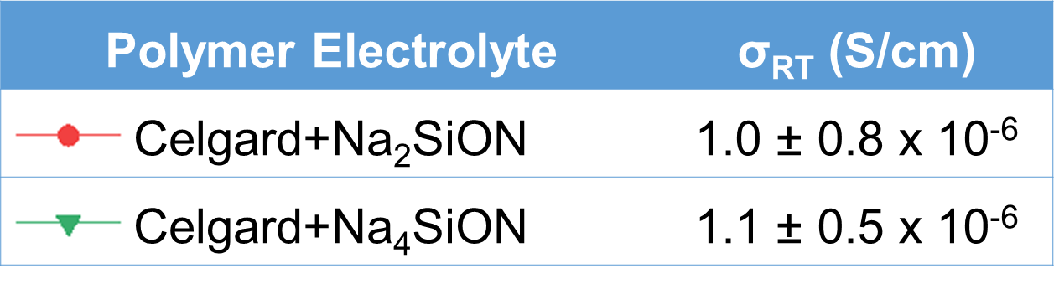

Slide 4
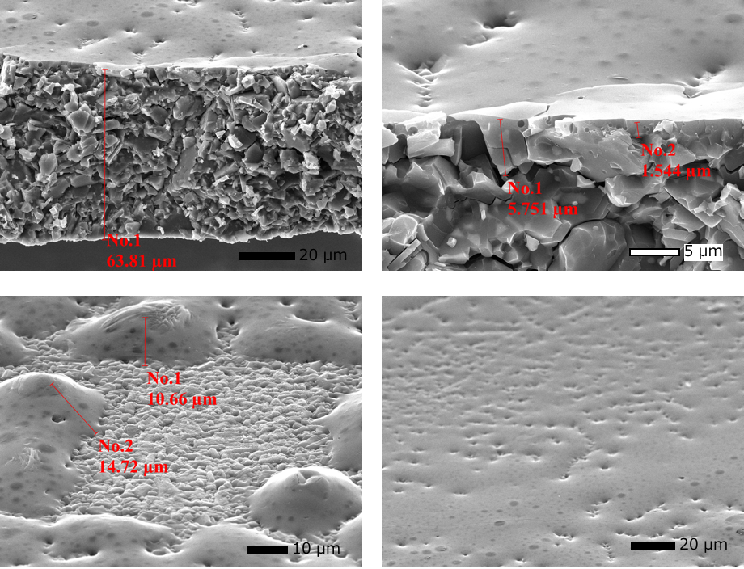
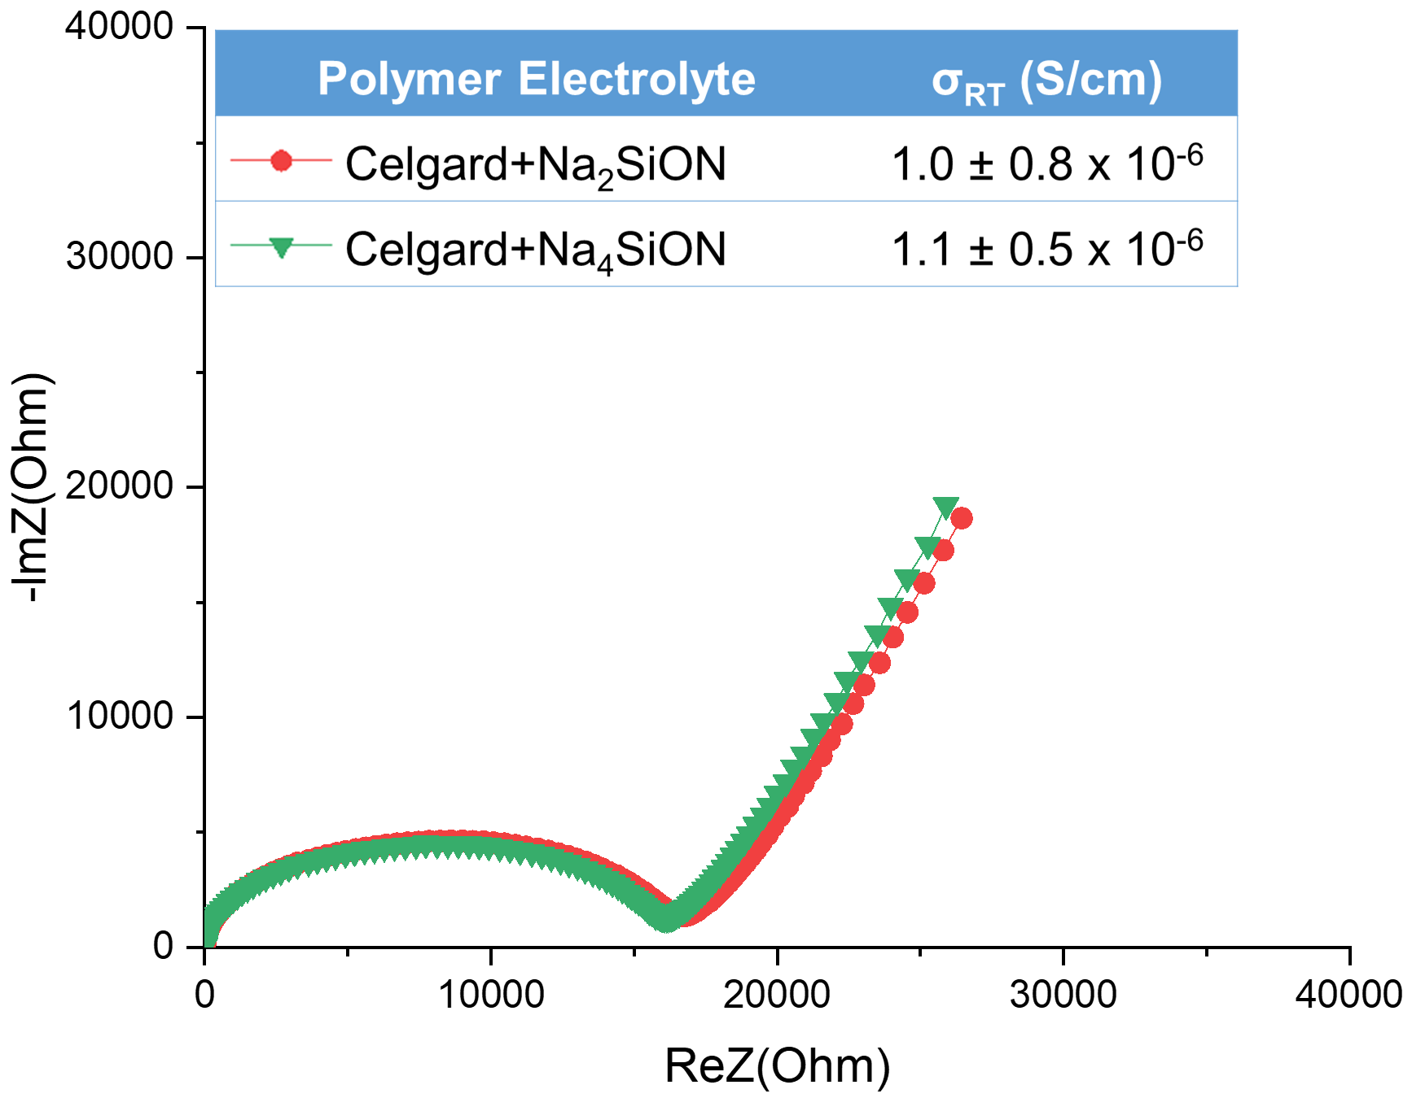
SEM Fracture Surfaces of Na₃SiPON coated NAMO
Stainless Steel (SS)/Na_{x}SiON PE/SS

